Slide 1

A Survey on the Accuracy and Performance of Video Anomaly Detection Models​
Project Advisor : Haonan Wang (Assistant Professor, Computer Engineering )

Slide 2




Team
016114696
Mounish Juvvadi
016151512
Lohith Kumar Reddy
Kondreddy
016075813
Santosh Sai Gowtham Pasala
016655951
Lokesh Reddy Gangasani

Slide 3

What is anomaly detection?

Slide 4
Types of Anomaly Detection
Statistical Anomaly Detection
Machine Learning Based - Anomaly Detection
Density Based - Anomaly Detection
Deep Learning - Based Anomaly Detection
Time Series Anomaly Detection

Slide 5
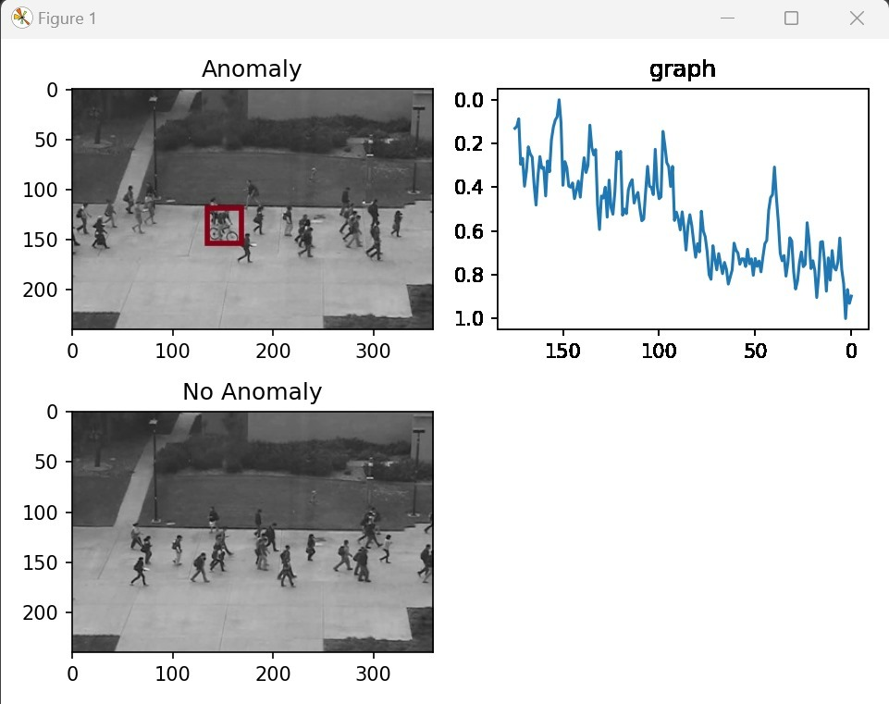

Slide 6
Objective
Evaluate four Video Anomaly Detection (VAD) models under various conditions, which include testing on diverse datasets, varying data sizes, and different frame sizes.
Also, evaluate four Video Anomaly Detection (VAD) models with different metrics, including AUC, PSNR and CPU time.

Slide 7
Data sets
PED 2
Avenue
Shanghai Tech

Slide 8
Models
DMAD (Diversity-Measurable Anomaly Detection)
AI-VAD (Attribute-based Representations for Accurate and Interpretable Video Anomaly Detection)
FAST ANO (Fast Anomaly Detection via Spatio-temporal Patch Transformation )
ASTNET (Attention-based Residual Autoencoder for Video Anomaly Detection)

Slide 9
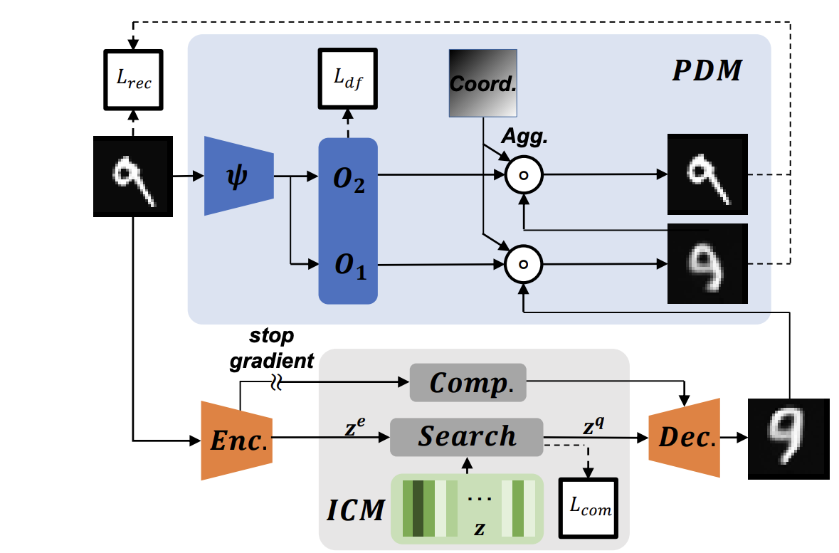
DMAD
Enhances anomaly detection by improving the reconstruction of diverse normal patterns while avoiding generalization on anomalies.
Uses a Pyramid Deformation Module and an Information Compression Module, proven effective on surveillance videos.

Slide 10
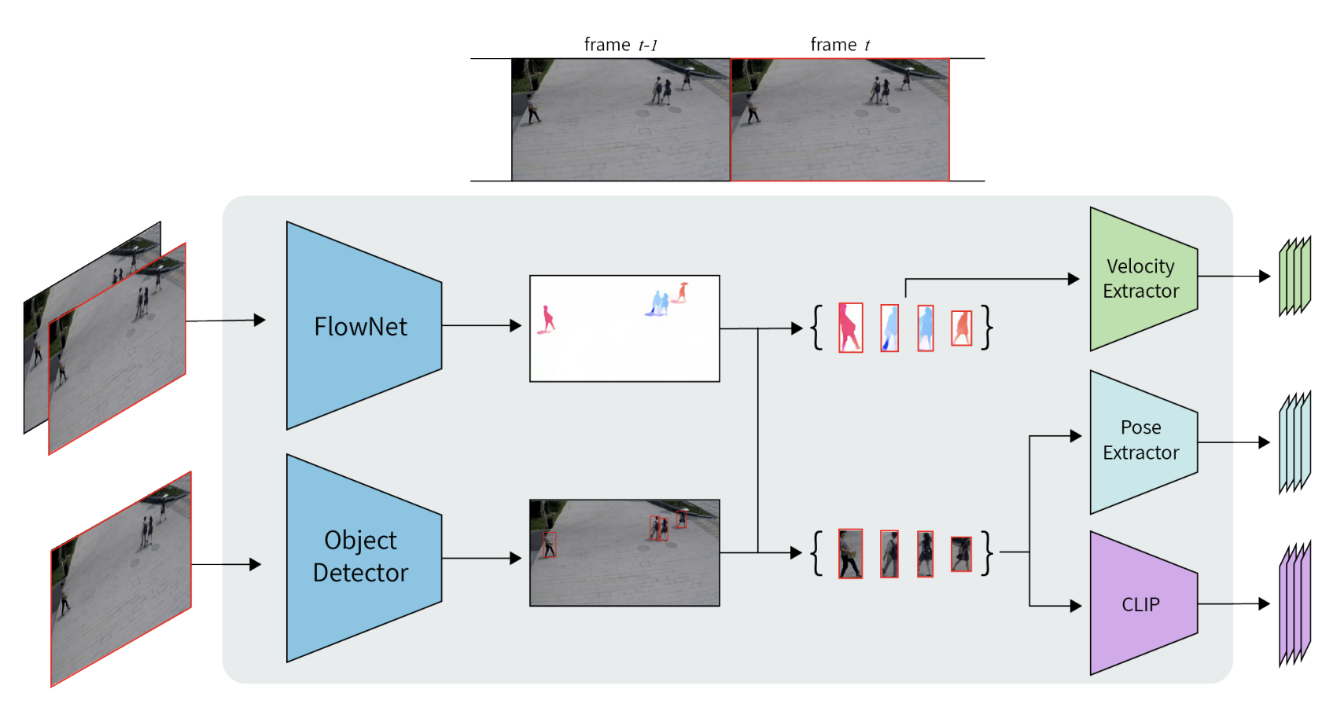
AI-VAD
Employs Flow Net 2.0 to analyse the movements of objects within video footage, identifying dynamic anomalies based on motion patterns.
Anomalies are scored using a combination of a Vision Transformer and a CLIP encoder, ensuring high accuracy in anomaly detection across major datasets.

Slide 11
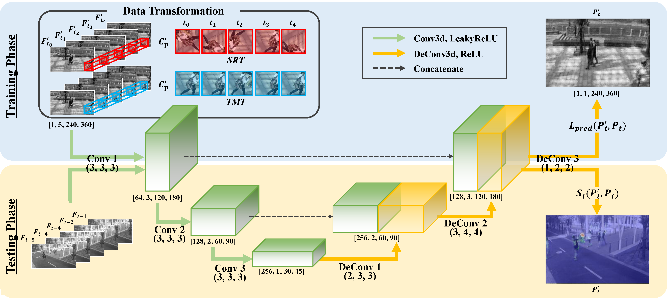
FAST ANO
Introduces spatial rotation transformation (SRT) and temporal mixing transformation (TMT) to generate irregular patch cuboids within normal frames.
Enhances the learning of normal features and addressing the shortcomings of computationally expensive prediction networks.

Slide 12
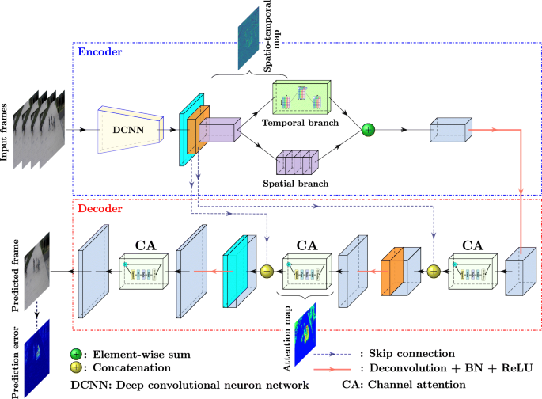
ASTNET
Uses a spatial-temporal network with a residual autoencoder and channel attention to effectively detect anomalies.
Extracts high-level features which are then channeled into temporal and spatial branches

Slide 13
Experiments
Data size (12% , 25% ,50% ,100%)
Frame size (128*128 , 256*256)
Training time
Testing time

Slide 14
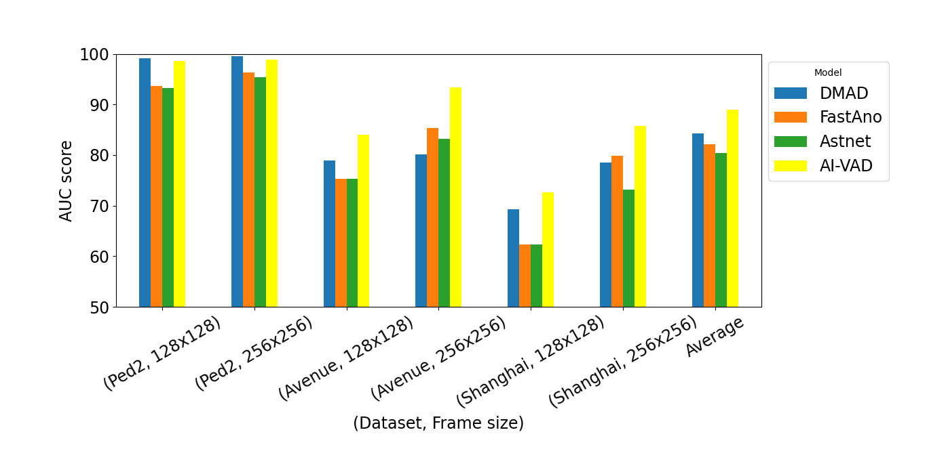
AUC

Slide 15
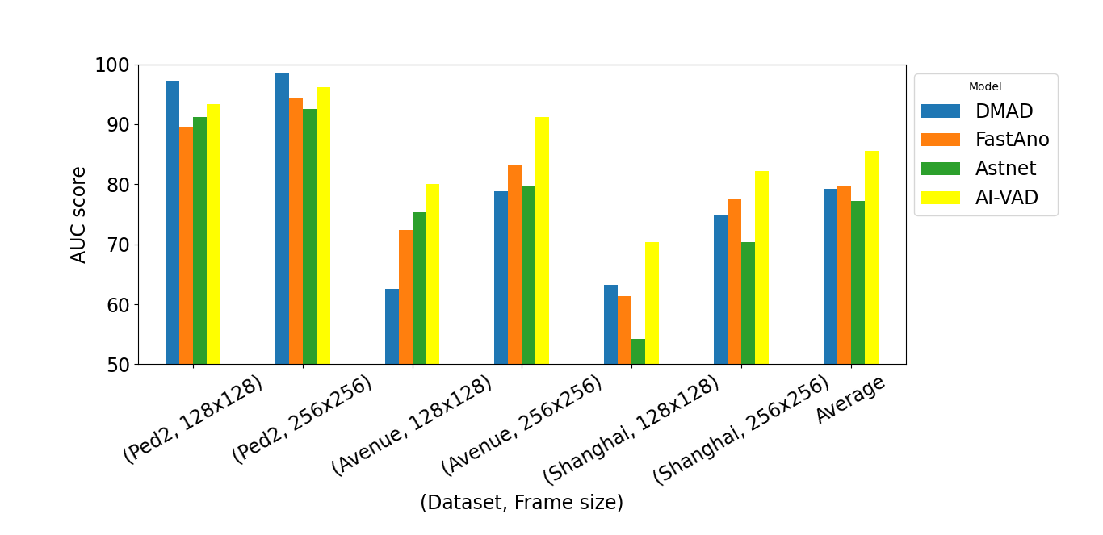

Slide 16
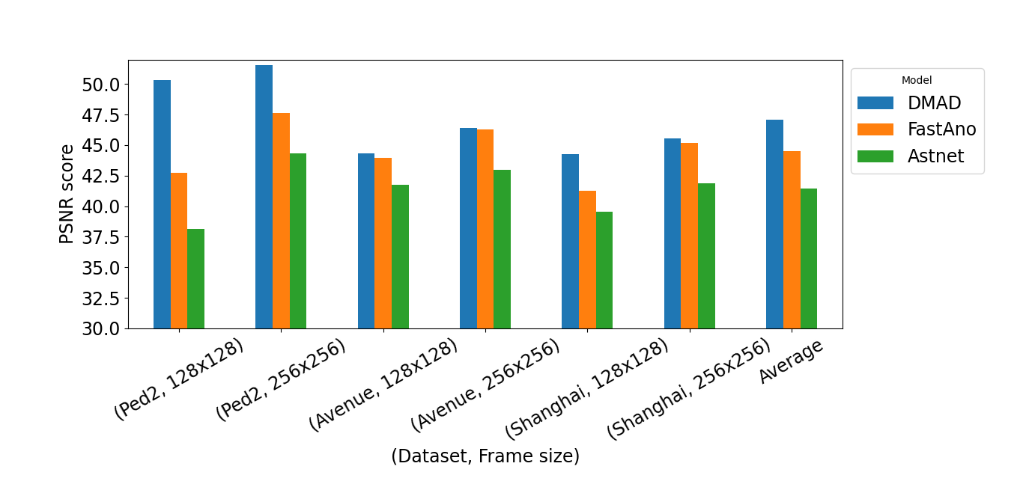
PSNR

Slide 17
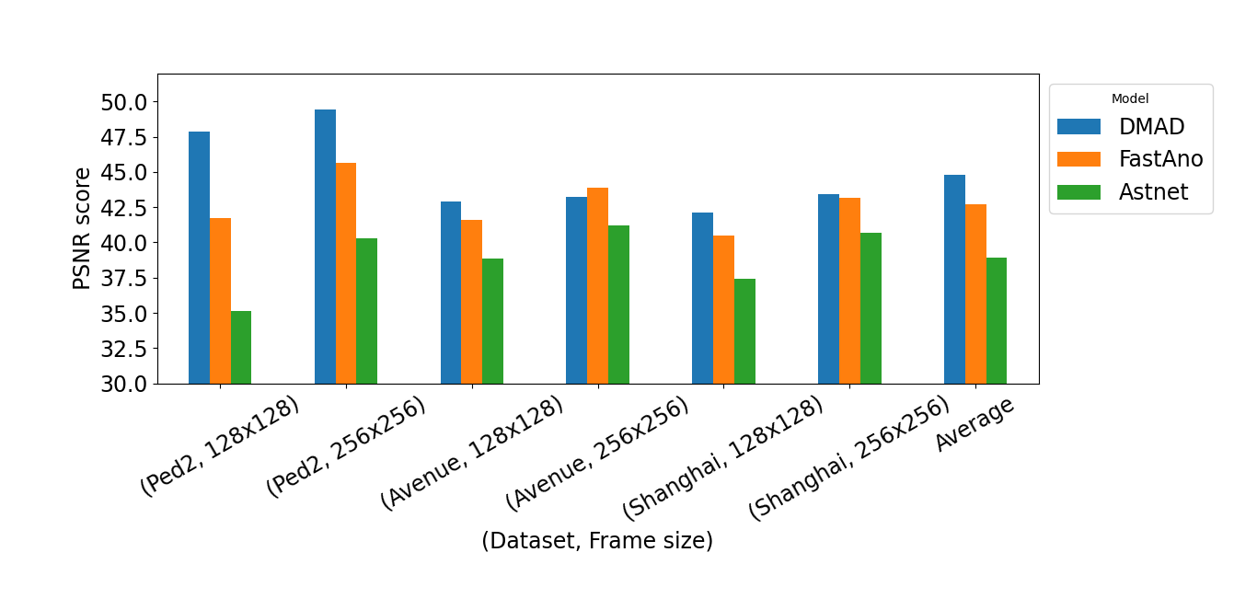

Slide 18
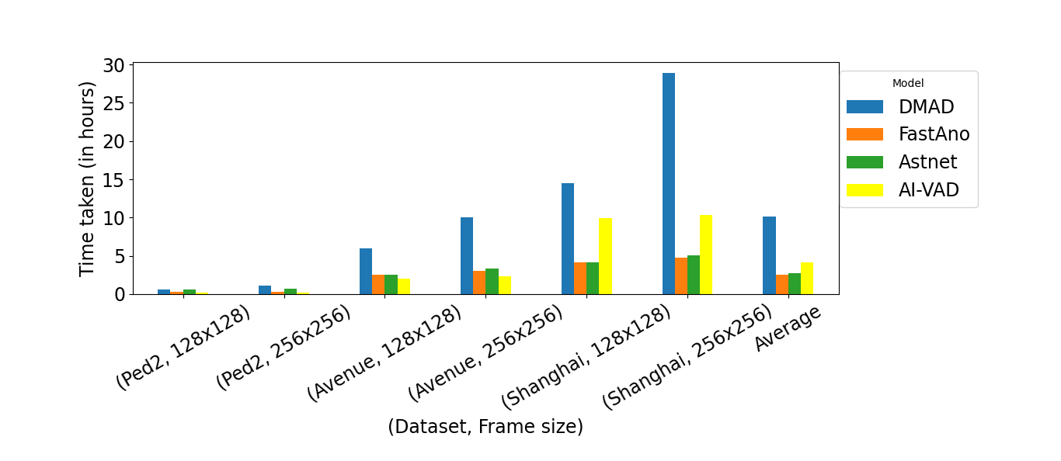
Training time and Inference

Slide 19
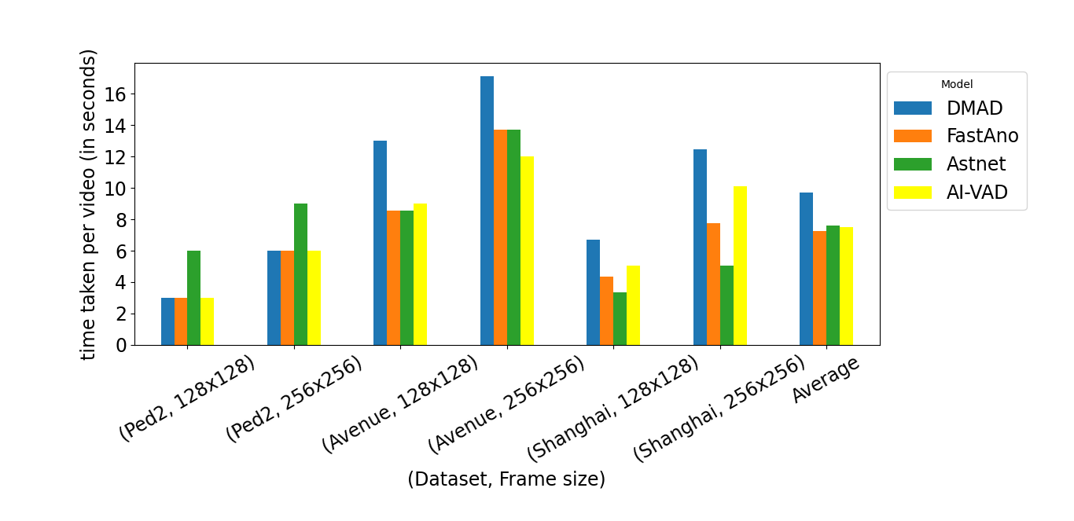

Slide 20
Conclusion
Overall, we found that AI-VAD is the most accurate model while only having slightly higher computational overhead compared to the fastest model.
We hope our study provides insights to the model, training dataset size, and frame size selections for other VAD users.

Slide 21
THANK YOU!
QUESTIONS?

